Slide 1
Report
May-2023 MP Inspection BFX – AT100
Date : 02-Oct-2023
Prepared by: Rachel Ruan

Slide 2
Issue Description
20-Jun, ALT customer complain [BFX-AT100] May & June – 2023 Mass production issue.
Overall inspection result => Fail ( Waived, due to product launch schedule )
Defect Total:
•Critical
No HDMI Output * 1pcs
UI broken * 1pcs
Abnormal reboot after System hang up * 1pcs
• Minor
HDMI Cable function NG* 1 pcs

Slide 3
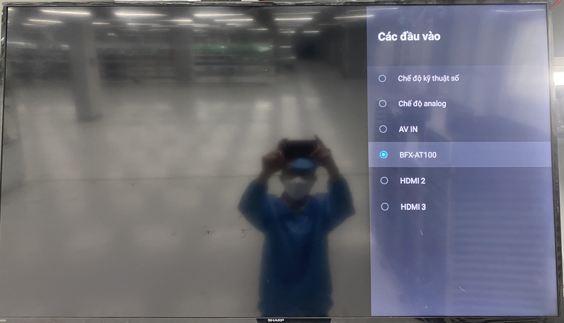
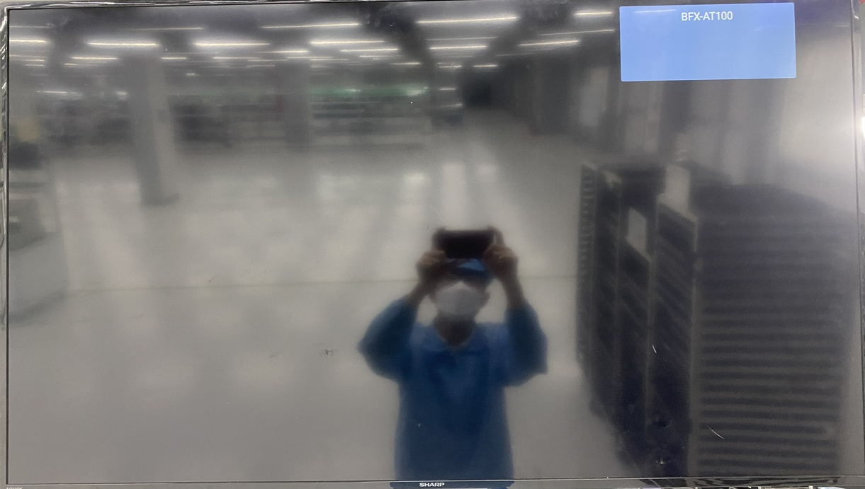
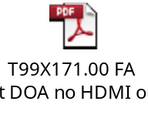
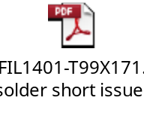
1. No HDMI Output - No HDMI TV screen
Issue Description | Root cause | Actions | Status
Symptom: No HDMI TV screen Type: Critical Defect unit Q’ty : 1pcs / 1000pcs Defect rate : 0.1% SKB SN: 2149688001202301131672 | 1. Check FATP data → Product test pass normally. FA : 2.1 Recheck production data record and test log ➔ Did not find out any abnormal. 2.2 Retest NG sample at OBA station => The fail symptom same as customer feedback. Use TV Sharp 32inch, 50inch, 60inch and TV SAMSUNG 50inch. => Result No HDMI TV screen. 2.3 Upgrade again factory FW and test NG sample at FT, FT1 station => Pass normally. => FATP station can’t cover this issue (The environment of 4K HDMI capture card is not the same TV) 3. Root Cause: 3.1: Occurrence Root Cause : Check visual inspection and take X-ray➔ Result: FIL1401 location solder short. Focus HDMI block, because FIL1401 solder short so TX2N and TX1P of HDMI port short with 7,7 Ohm. 3.2: Escape Root Cause : FATP station can’t cover this issue . | 1. Update SOP VI PCBAs 100% at location FIL1401 & FIL1402 with the magnifier . ( Owner IE: Ms.Yen – Done 03/Jul). 2. Update new environment at RC1 station of FATP. As the verification result, new environment at RC1 station of FATP can cover error no HDMI TV screen. (Owner: TE Jones ,status: Done 08/18). 3. Fii applies new environment at RC1 into production to cover this issue. (Owner: TE Jones ,status: Done 08/18).
No screen HDMI

Slide 4
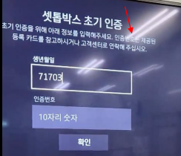
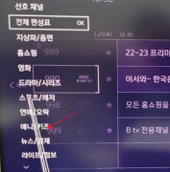
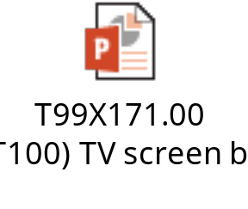
2. UI broken - UI Screen is unstable (broken)
Issue Description | Root cause | Actions | Status
Symptom: UI Screen is unstable (broken) Type: Critical Defect unit Q’ty : 1/1000pcs Defect rate : 0.1% SKB SN: 2149688001202301117565 | ALT initial review • Check visual status -> No found abnormal • TV change (LG/Samsung), HDMI Cable change -> still has defect Check FATP data → Product test pass normally. Root cause: - Occur cause: Suspect U1 SoC (P/N: 002.02753.005, DC: 2230, Vendor: AMLOGIC) have material issue. - Escape cause: FATP can’t cover issue. | 1. Co-work with RD, TE team, how to cover this issue at FATP , Owner :RD Jerry ,TE Jones. Due date: 09/18. 27-Sep, RD feedback mail . FATP cannot be checked through software. 2. Confirm ALT customer before swap U1 component to verify SoC issue. Owner : PQE Rachel
UI screen is unstable (broken).

Slide 5
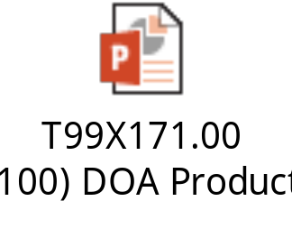
3. Abnormal reboot after System hang up
Issue Description | Root cause | Actions | Status
Symptom: Abnormal reboot after System hang up Type: Critical Defect unit Q’ty : 1pcs / 1000pcs Defect rate : 0.1% SKB SN: 2149688001202301146495 | Symptom • Normal operation for several minutes after power on • Abnormal reboot and System hang up ALT initial review • Check visual status -> No found abnormal • USB log is attached : Log.zip 1. Check FATP data → Product test pass normally. 2. Root cause: 1. Occur cause: Under RD Taiwan further analysis 2. Escape cause: FATP can’t cover this issue, Because NG board Auto reboot after about 10-20minutes booting (unstable) then after next is hang up/reboot FATP so can’t cover 100% this issue. | Action: 1. Send NG sample to RD support analysis find out root cause. Owner: PM An, RD Cooper. Due date 09-Sep. 2. Recheck data on Y2023 produce q’ty 250000pcs, OBA tested 4195pcs not find out the same issue. 3. PE keep monitoring this issue on next build. Owner: PE Long
Screen logo hang-up

Slide 6
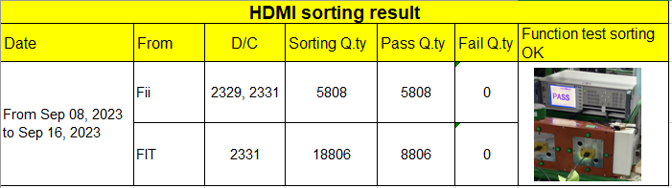

4. HDMI Cable function NG
Issue Description | Root cause | Actions | Status
Symptom: HDMI Cable function NG Type: Minor Defect unit Q’ty : 1/1000pcs Defect rate : 0.1% SKB SN: 2149695001202201009369 | 1. Fail symptom: As ALT feedback that they found out 1pcs No HDMI Output screen on the TV. 2. Check HDMI data: PN: 371.01057.005 Vendor : FIT Description : CABLE HDMI 19P 1800+-30mm BLACK GP Qty : 1pcs 1. HDMI incoming cosmetic & function issue, Fii feedback to FIT vendor and request 8D report to FIT Quality team . Done: 01-Jul-2023 2. IQC OP no defect this issue when checking HDMI incoming material. 3. Online product no check accessory cosmetic and fucntion, OBA check accessory follow AQL 0.65, no defect this issue. | 1. Hang quality alarm on IQC control HDMI cable incoming this issue, if IQC defect, will reject HDMI cable back vendor. 2. Add to IQC-SIP checking HDMI cosmetic and function issue. Status: Done 3. Add to SIP OBA check cosmetic and function HDMI ( accessory checking ). Status : Done. 3. FIT sorting function 24614 pcs, result no defect NG issue. Done

